Slide 1

Spectrum 2024

Slide 2
Spectrum summary(Total Bandwidth MHz)
Circle | Vi Spectrum(Jul'2024) |  |  |  |  |  |  | Jio Spectrum(Jul'2024) |  |  |  |  |  |  | Airtel Spectrum(Jul'2024)
 | 4G |  |  |  |  | 5G |  | 4G |  |  |  |  | 5G |  | 4G |  |  |  |  | 5G
 | 800 | 900 | 1800 | 2100 | 2300 | 3500 | 26000 | 800 | 900 | 1800 | 2100 | 2300 | 3500 | 26000 | 800 | 900 | 1800 | 2100 | 2300 | 3500 | 26000
Andhra Pradesh |  | 7.4 | 10 | 5 |  | 50 | 200 | 10 |  | 10 |  | 40 | 100 | 1000 |  | 9 | 21.4 | 5 | 30 | 100 | 800
Assam |  | 0 | 25 | 5 |  | - | - | 10 |  | 10 |  | 40 | 100 | 1000 |  | 15 | 15 | 15 | 40 | 100 | 800
Bihar |  | 0 | 17.8 | 5 |  | 50 | - | 10 |  | 15 |  | 40 | 100 | 1000 |  | 12 | 20.2 | 15 | 40 | 100 | 800
Delhi |  | 10 | 10.6 | 5 |  | 50 | 200 | 10 |  | 10 |  | 40 | 100 | 1000 |  | 6 | 7 | 15 | 30 | 100 | 800
Gujarat |  | 11 | 20.8 | 10 |  | 50 | 450 | 10 |  | 20 |  | 40 | 100 | 1000 |  | 4.2 | 10 | 15 | 40 | 100 | 800
Haryana |  | 12.2 | 15.8 | 15 |  | 50 | 400 | 10 |  | 10 |  | 40 | 100 | 1000 | 5 | - | 15 | 15 | 40 | 100 | 800
Himachal Pradesh |  | 0 | 11.2 | 5 |  | - | - | 10 |  | 10.4 |  | 40 | 130 | 1000 |  | 10 | 20 | 5 | 40 | 100 | 800
Jammu & Kashmir |  | 0 | 17 | 5 |  | - | - | 10 |  | 10 |  | 40 | 130 | 1000 |  | 15 | 15 | 15 | 40 | 100 | 800
Karnataka |  | 7.2 | 15 | 10 |  | 50 | 200 | 10 |  | 10 |  | 40 | 130 | 1000 |  | 8.8 | 20 | 10 | 30 | 100 | 800
Kerala |  | 12.4 | 20 | 10 | 10 | 50 | 800 | 10 |  | 10 |  | 40 | 130 | 1000 |  | 4.6 | 10 | 15 | 30 | 100 | 800
Kolkata |  | 7.2 | 15 | 10 |  | 50 | 200 | 10 |  | 10 |  | 40 | 100 | 1000 |  | 7 | 20 | - | 30 | 100 | 800
Madhya Pradesh |  | 7.4 | 19.8 | 5 | 10 | 50 | 400 | 10 |  | 20 |  | 40 | 130 | 1000 | 5 | - | 15 | 10 | 30 | 100 | 800
Maharashtra |  | 14 | 12.4 | 15 | 10 | 50 | 400 | 10 |  | 20 |  | 40 | 100 | 1000 | 5 | - | 20 | 10 | 30 | 100 | 800
Mumbai |  | 11 | 10.2 | 10 |  | 50 | 150 | 15 |  | 10 |  | 40 | 100 | 1000 |  | 5 | 15 | 5 | 30 | 100 | 800
North East |  | 0 | 25.8 | 5 |  | - | - | 10 |  | 10 |  | 40 | 130 | 1000 |  | 15 | 10 | 15 | 40 | 100 | 800
Odisha |  | 5 | 17 | 5 |  | - | - | 10 |  | 20 |  | 40 | 100 | 1000 |  | 10 | 20 | 5 | 40 | 100 | 800
Punjab |  | 6.8 | 15 | 10 |  | 50 | 300 | 10 |  | 10 |  | 40 | 100 | 1000 |  | 10 | 20 | 5 | 40 | 100 | 800
Rajasthan |  | 6.8 | 10 | 15 |  | 50 | 300 | 10 |  | 20 |  | 40 | 130 | 1000 |  | 10 | 15 | 15 | 40 | 100 | 800
Tamil Nadu |  | 7.4 | 11.4 | 15 |  | 50 | 300 | 10 |  | 10 |  | 40 | 100 | 1000 |  | 5 | 20 | 10 | 30 | 100 | 800
Uttar Pradesh (E) |  | 6.8 | 10 | 20 |  | 50 | 250 | 10 |  | 20 |  | 40 | 100 | 1000 |  | 10 | 16.8 | 5 | 40 | 100 | 800
Uttar Pradesh (W) |  | 10 | 15 | 10 |  | 50 | 350 | 10 |  | 10 |  | 40 | 130 | 1000 | 5 | - | 15 | 15 | 40 | 100 | 800
West Bengal |  | 6 | 21.6 | 5 |  | 50 | 400 | 10 |  | 20 |  | 40 | 100 | 1000 |  | 10 | 12 | 15 | 40 | 100 | 800
Total | 0 | 148.6 | 346.4 | 200 | 30 | 850 | 5300 | 225 | 0 | 295.4 | 0 | 880 | 2440 | 22000 | 20 | 148.6 | 310.4 | 215 | 700 | 2200 | 17600

Slide 3
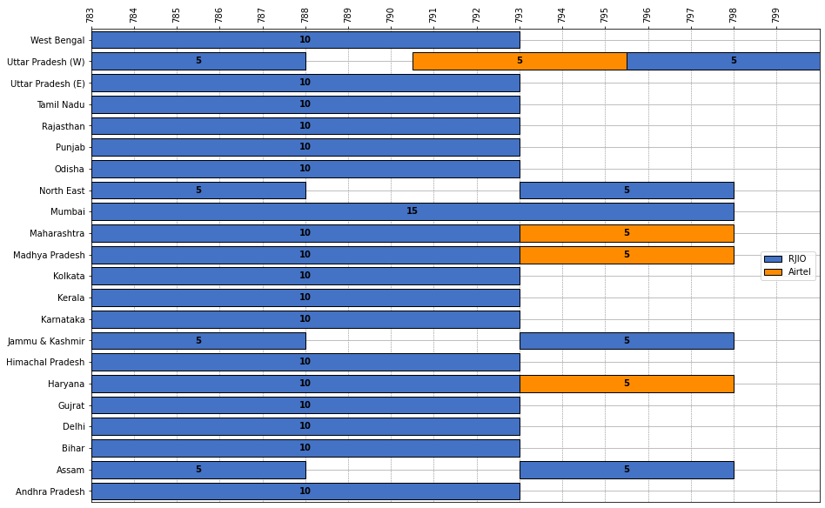
Band-800 MHz

Slide 4
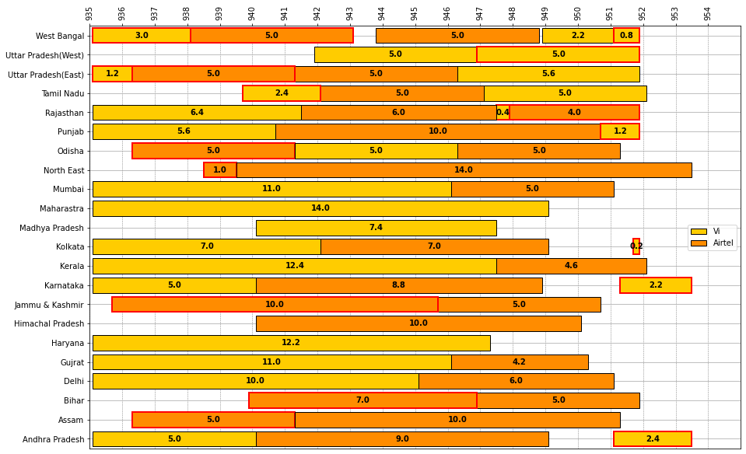
Band-900 MHz
Auction’24 :Red colour border

Slide 5
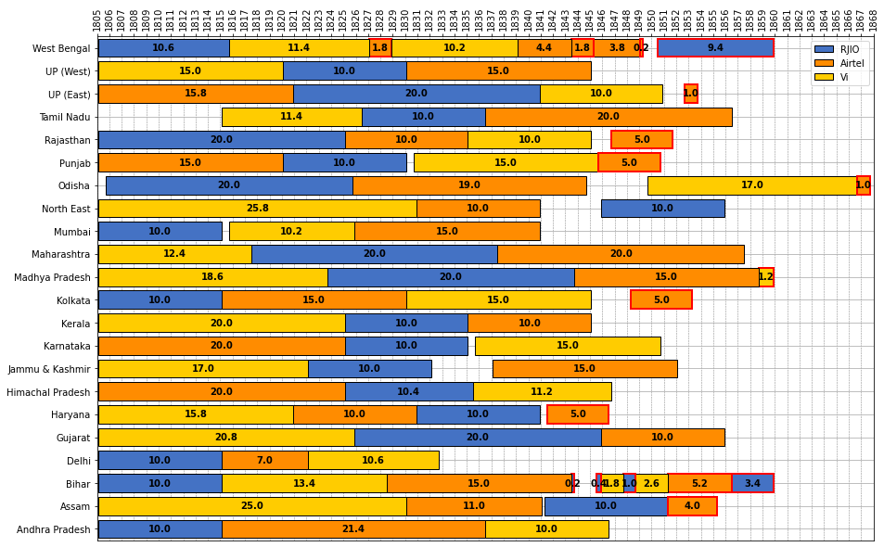
Band-1800 MHz
Auction’24 :Red colour border

Slide 6
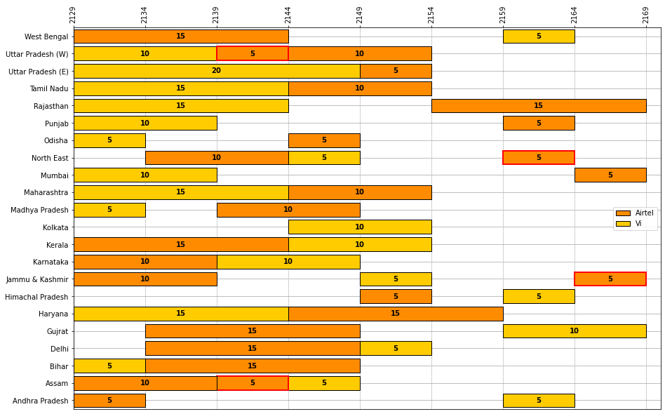
Band-2100 MHz
Auction’24 :Red colour border

Slide 7
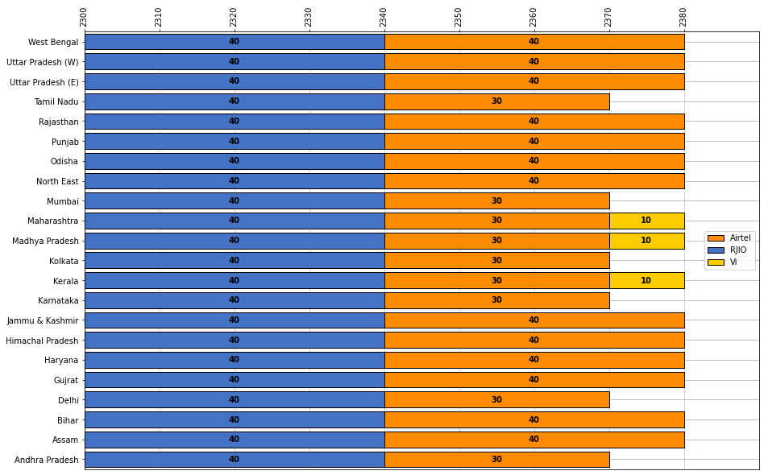
Band-2300 MHz

Slide 8
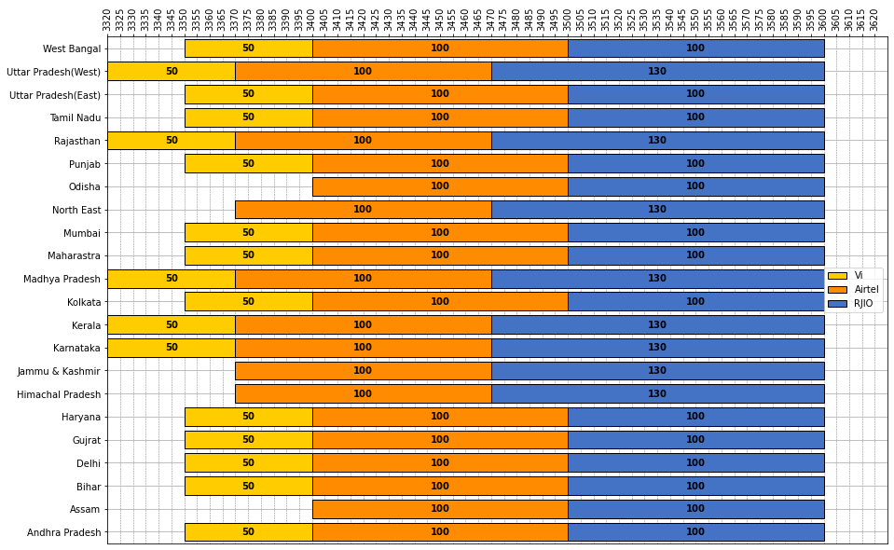
Band-2300 MHz

Slide 9
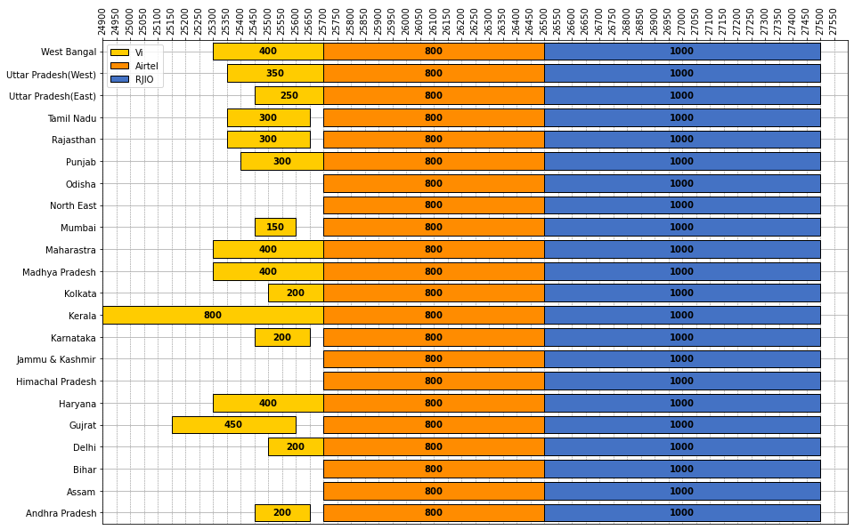
Band-26000 MHz

Slide 10
Thank You

